Slide 1


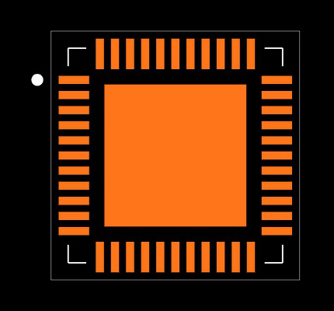



SYSTEM ARCHITECTURE

